Slide 1
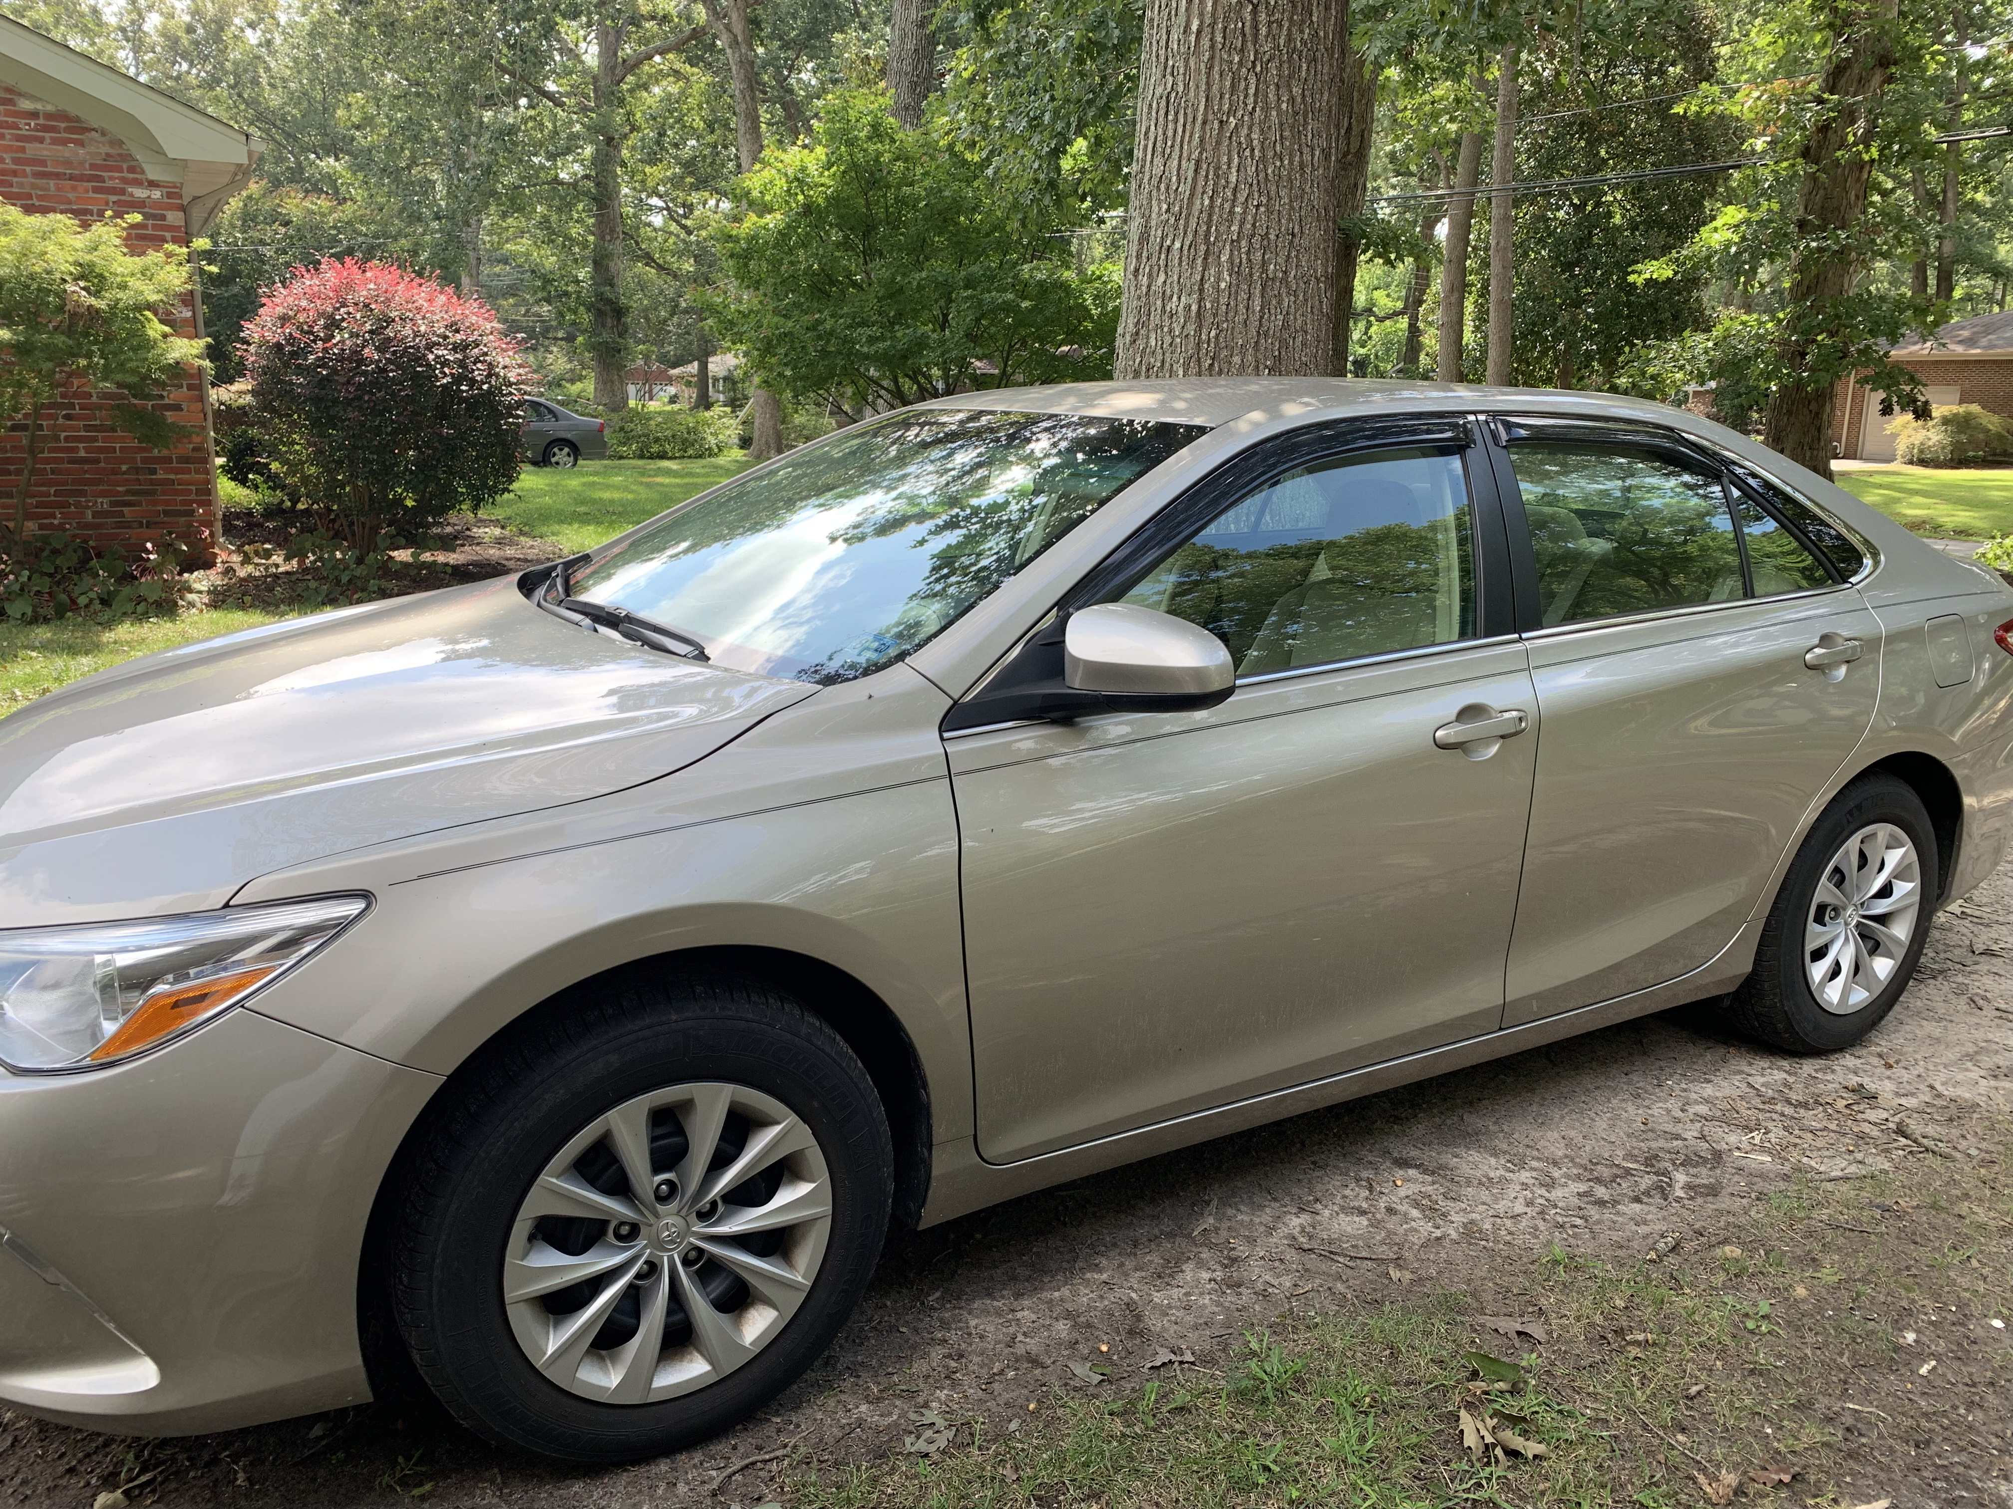



Storyboard for Sedan (Toyota Camry) page
Toyota Camry (2016)
(Sedan)
Jake Lionetti
Menu
© Photo taken by me
Cost | $26,000
Weight | 3,240 lbs
Mpg | City/highway – 25/35
Transmission | 6-speed shift able automatic
Drive type | Front wheel drive
Cylinders | Inline 4
Warranty | 3 yr./ 36000 mi.

Slide 2
Sedan page description
Choose to use the Toyota Camry (2016 model)
Picture taken by me
Shows a menu button in the right hand corner
The theme that we are going for is a darker blue (background) and gray (for the specs)

Slide 3

Storyboard for home page
Jake Lionetti
Menu
Murphy’s Auto (logo)
321 Auto Street
(000)-000-000
Contact.murphys@murphysauto.com
© Stock image from Microsoft Powerpoint

Slide 4
Home page description
Added a menu button for easy to use navigation
Contact information
Picture
Logo

